Slide 1
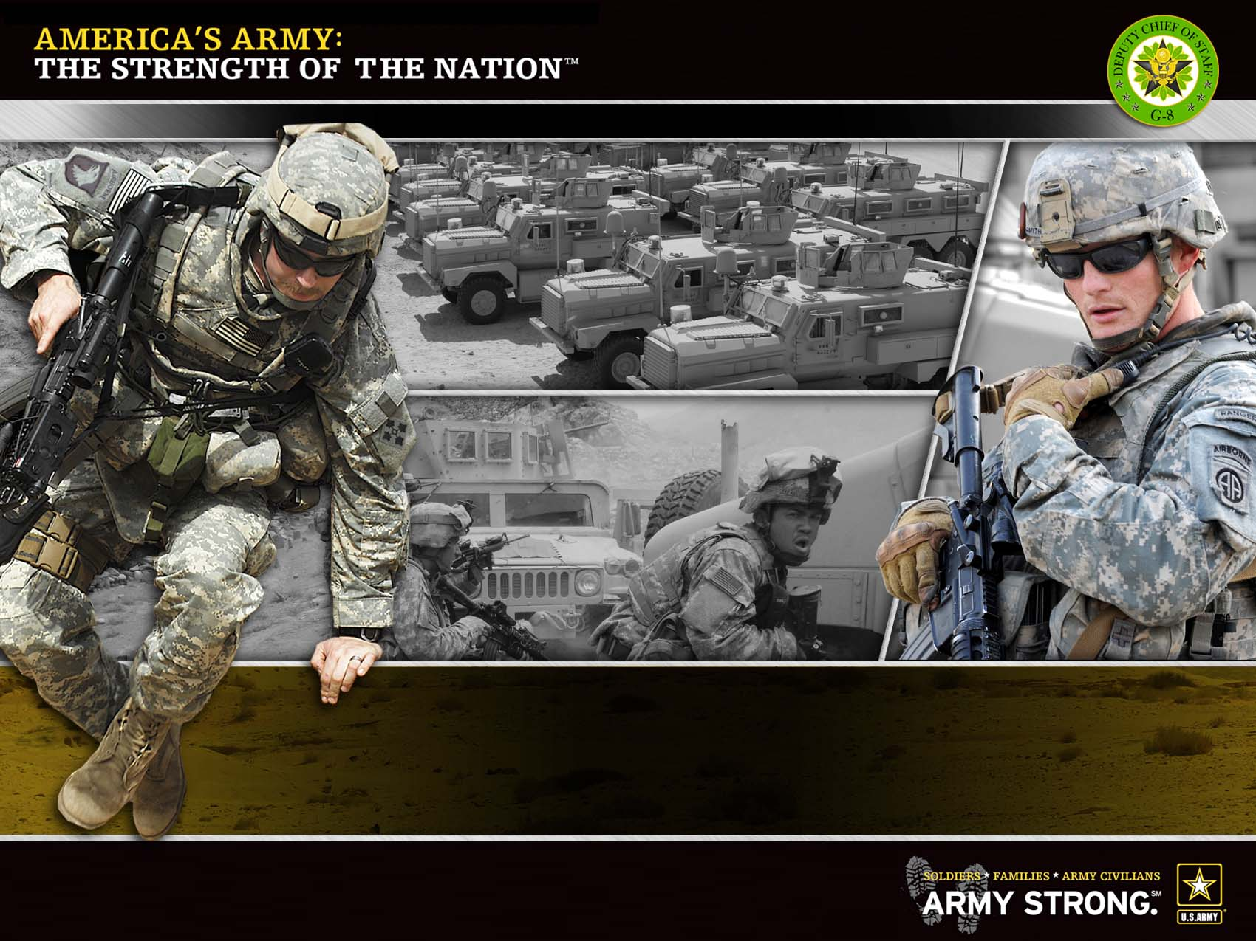
UNCLASSIFIED
G-1
SHARP Annual Unit Refresher Training
(Pre and Post Deployment)
2 Jun 10
Notes:
1

Slide 2
Damage resulting from sexual harassment and sexual assault extends far beyond the victim. It weakens the very health and morale of our Soldiers and civilians by breaking the bond of trust within our Army team.
Notes:
MOTIVATOR

Slide 3
Terminal Learning Objectives
Action | Demonstrate behavior consistent with the Army’s Sexual Harassment and Assault Response and Prevention (SHARP) Program
Conditions | As Commanders, managers, Soldiers, and civilians confronted with real-life scenarios involving potential and actual sexual harassment and sexual assault
Standards | Upon completion of this lesson, commanders, managers, Soldiers, and civilians will be able to demonstrate behavior consistent with the Army’s SHARP Program to eliminate sexual harassment and sexual assault from the Army , with 100% accuracy: Define the Army’s sexual harassment and sexual assault policies and prevention strategy Recognize potential sexual harassment behavior Recognize potential sexual assault behavior Apply techniques to safely intervene to prevent sexual harassment and sexual assault Identify reporting options, procedures, and the importance of reporting Describe the role of commanders, managers, Soldiers, and civilians in preventing sexual violence
Refresher Training TSP

Slide 4
S.R.E.E.
SAFETY:
RISK:
ENVIRONMENTAL CONSIDERATIONS:
EVALUATION:

Slide 5
INSTRUCTIONAL LEAD-IN
This lesson stresses the seriousness of sexual harassment and sexual assault and importance of ensuring the Army’s contemporary operating environment is safe and promotes an environment free of sexual harassment and sexual assault. It will enhance your knowledge on sexual harassment and sexual assault behaviors and provide prevention techniques that you can apply to your daily activities.

Slide 6
Sexual Harassment vs. Sexual Assault
What is the difference between sexual harassment and sexual assault?
Sexual Harassment
Sexual Assault
Sexual Harassment involves verbal, non-verbal and physical behaviors
Sexual Assault involves sexual contact characterized by use of force

Slide 7
Harassment
Harassment includes, but is not limited to any offensive conduct such as slurs, jokes, or other verbal, nonverbal or physical conduct that has the purpose or effect of unreasonably interfering with an individual’s work performance or creating an intimidating, offensive, or hostile environment.
Workplace harassment based on race, religion, color, sex, national origin, age (40 and over), disability, genetic information, reprisal, or other impermissible basis is not acceptable in either the military or civilian ranks.

Slide 8
Sexual Harassment
Sexual harassment is a form of sex discrimination.
Sexual harassment includes unwelcome sexual advances, requests for sexual favors, and other verbal or physical conduct of a sexual nature when:
Submission to or rejection of is made a term or condition of a person’s job, pay, career
Submission to or rejection of is used as a basis for career or employment decisions
Conduct has the purpose or effect of unreasonably interfering with an individual’s work performance or creates an intimidating, hostile, or offensive work environment

Slide 9
Definition of Sexual Assault
Sexual assault - intentional sexual contact, characterized by use of force, physical threat or abuse of authority or when the victim does not or cannot consent; sexual assault can occur without regard to gender, spousal relationship, or age of victim
Consent will not be deemed or construed to mean the failure by the victim to offer physical resistance
Consent is not given when a person uses force, threat of force or coercion, or when the victim is asleep, incapacitated, or unconscious
AR 600-20, Paragraph 8-4

Slide 10
Understanding the Magnitude of the Problem
Sexual Harassment Affects Men and Women
Who do you think has experienced sexual harassment in the Army? Of those surveyed in the ARI Human Relations 2009 Operational Troops Survey….
Male officers: 40%
Female officers: 60%
Male enlisted Soldiers: 50%
Female enlisted Soldiers: 70%
FY10-06-05 Army Civilian Attitude Survey – Harassment
8% of 6,639 Non-Supervisors Surveyed
6% of 1,302 Supervisors Surveyed
8 %

Slide 11
Understanding the Magnitude of the Problem Con't
Sexual Assault is a Crime
According to Army sexual assault data for FY2009:
67% of violent crime in the Army was due to sexual assaults
59% of sexual assaults were “Blue on Blue”
Bottomline: Sexual assault is a crime that is endangering the Army from the inside out

Slide 12
Understanding the Magnitude of the Problem Con't
What’s the Impact?
How does sexual harassment and sexual assault affect Soldiers and civilians in their units and communities?
It undermines the strength of our Army and fundamentally goes against the Warrior Ethos, the Army Civilian Corps Creed, and the Army Values

Slide 13
Effects of Sexual Harassment/Assault
Individual
Unit
Community
Isolation
Depression
Degrading of individual
Difficulty with trust
Excessive absenteeism
Loss of career
Post Traumatic Stress Syndrome
Loss of unit cohesion
Inability to accomplish goals/mission
Decreased unit readiness
Low morale
Excessive absenteeism
Loss of personnel
Loss of safety
Diminishes community relations
Instability
Higher rates of violent crime
Degradation to community
Bottomline: Sexual harassment and sexual assault endanger the lives of individuals and threaten the Army’s mission.

Slide 14
Why Is This Important?
If we know that sexual harassment and sexual assault are wrong, why do these behaviors continue?
Answer: Because we as a society allow it to happen.
As leaders, why is it important for us to stop sexual harassment and sexual assault?
Answer: We all have a responsibility to take action to change our culture to eliminate an “enemy that lies within our ranks.” (CSA General Casey, SHARP Summit 2010)
We are all leaders, and as leaders there is no such thing as a passive bystander. Each of us is either enabling sexual harassment and sexual assault or standing up to stop it.

Slide 15
Preventing Sexual Harassment/Sexual Assault
Why Prevention?
As a society, the Army does not tolerate crime or mistreatment of its Soldiers and civilians
Army’s Standards of Conduct apply equally to all Soldiers
Prevention
Attacks the issue at the earliest point
Makes life safer on and off-post
Aligns with and reinforces Army Values
Keeps the focus on the mission
Enhances unit camaraderie
Maintains goodwill

Slide 16
The Army's Strategy
Phase I: Committed Army Leadership
Exit Criteria
Launched
Sep 2008
Aggressive Senior Leader Condemnation
Develop Baseline
Start: Propensity to report: 33%
Phase II: Army-Wide Conviction
Ownership of Sexual Assault Prevention
Launched
April 2009
Post-Year 2 Propensity to report: 50%
Post-Year 2 Assaults reduced by 15%
Phase III: Achieve Cultural Change
DoD’s Retention Leader
Projected Launch
FY12
Post-Year 4 Propensity to report: 70%
Post-Year 4 Assaults reduced by 25%
Phase IV: Sustainment, Refinement, and Sharing
Blueprint for the Nation
Projected Launch
FY13
Post-Year 5 Propensity to report: 90%
Post-Year 5 Assaults reduced by 50%

Slide 17
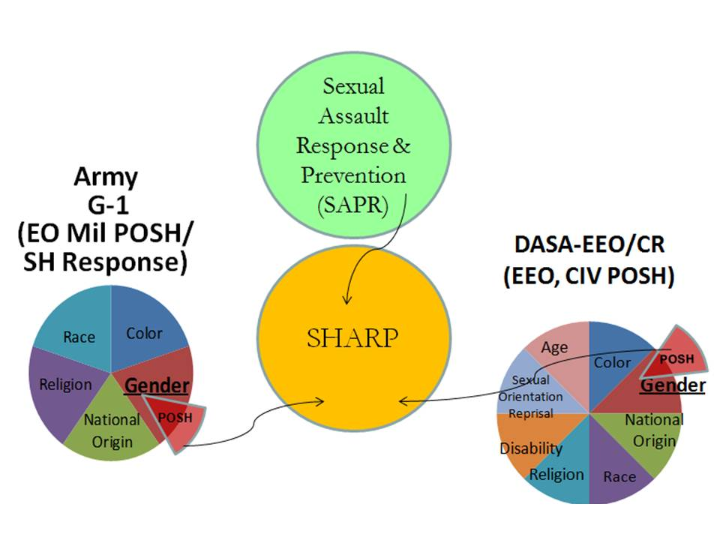
Transitioning to SHARP
SAPR + POSH = SHARP
Sexual Assault Prevention & Response (SAPR)
Military POSH*
Civilian POSH**
Sexual Harassment/Assault Response and Prevention
* Prevention and response
** Prevention only

Slide 18
Transitioning to SHARP
Transforming Units
2010 - 2012
2013 and Beyond
Field Army
Collateral duty
(except for contractors)
(Soldiers and civilians)
Civilian Full-Time
Employee
Corps
Division
Brigade
Collateral duty
(Soldiers and civilians)
Battalion
Company
Notes:
Beginning in 2010, Commanders select personnel to serve as SHARP personnel. Sexual assault and sexual harassment response and prevention is no longer handled by separate offices.
SHARP personnel still take their orders and set their performance goals from their supervisors in their chain of command and report up to the same Commander.
Through 2011, SHARP personnel work is considered collateral duty for both civilian and military personnel. For contracted SHARP personnel, it is full-time duty.
Beginning in 2012, SHARP personnel at the brigade or higher levels work full-time on sexual harassment and assault issues. SHARP personnel at the brigade or higher level do the same type of work whether they are in garrison or in theater.
Beginning in 2012, SHARP work at the battalion of lower levels is still considered collateral duty. SHARP personnel at these levels are required to take an initial 80 hours of training and annual refresher training. It is recommended but not required that SHARP personnel at these levels stay in the positions for two years.
Beginning in 2010, the SHARP office will issue guidance and recommendations to SHARP personnel; however, SHARP personnel will continue to take direction from their Commanders.

Slide 19
Your Role is Critical
To defeat sexual harassment and sexual assault it’s up to Soldiers and civilians to take a stand. The Army needs you to:
Treat all Soldiers and civilians with dignity and respect
Recognize that the Army’s SHARP policies apply without regard to a person’s rank, age, gender and sexual orientation neutral. A person’s sexual orientation is a personal and private matter
Take ownership for eliminating the “enemy within our ranks”
Intervene to prevent sexual harassment and sexual assault
Encourage Soldiers and civilians to report incidents
Make the Army the DoD leader and “blueprint for the nation”

Slide 20
How Does it All Start?
Approximately one-third of all reported sexual assaults within the Army are preceded by sexual harassment.

Slide 21
Foundations of Sexual Violence
We need to attack this issue at the lowest level
Death
Intentional, forced, non
consensual sexual contact
Sexual
Assault
A form of discrimination that
is explicitly sexual or
contains sexual overtones
Sexual Harassment
An indirect remark
suggesting something rude
Sexual
or sexual in nature
Innuendo

Slide 22
Intervention…The Army is Changing its Approach
 | Old Approach | New Approach
Goal: | Eliminate crime | Cultural change: I. AM. STRONG
Focus: | Risk avoidance | Prevention
Target: | Potential victim | Potential offender
Primary Responsibility: | Victim | Bystander
Sexual Harassment and Sexual Assault: | Two separate issues | Two related issues
Approach: | Avoid becoming the target | Intervene to stop potential sexual harassment and sexual assault
Key Message: | Protect yourself | Every Soldier and civilian has a duty to intervene to prevent sexual harassment/assault

Slide 23
Intervention is the Cornerstone…
It is the Army’s approach for eliminating sexual harassment and sexual assault
It stops sexual harassment and sexual assault before it happens
It uses each person’s behavior to influence others
It changes the rules of acceptable behavior

Slide 24
Shortly, a training video will be shown which depicts how sexual harassment or sexual assault can occur in daily-life settings.
The video contains adult language and content that viewers could find offensive.
Civilian employees are not required to attend this portion of the training.
There will be breaks both before and after the portion of training dealing with this video.
Notes:
This slide must be both displayed AND READ by the instructor.

Slide 25
BREAK
Notes:
READ PRIOR TO DISMISSING CLASS:
We will take a short 5 minute break before beginning the video
Any civilian employee who wants to excuse themselves from the video and its corresponding discussion should return in __ minutes; according to the clock in the room, that would be ____ (insert return time).

Slide 26


Slide 27
BREAK
Notes:
We will take a short break; please be back at ____ (should match the return time given prior to the video).

Slide 28
Why Don’t We Intervene?
Fear
Inability to accurately identify potential sexual harassment/assault behavior
Peer pressure
Impact of hierarchy or chain of command
Conflict avoidance
Perception of social norms, peers’ attitudes, and standards of behavior

Slide 29
Why Should You Intervene?
It is your responsibility as a Soldier or civilian
Intervening supports the Army Values, the Warrior Ethos and the Army Civilian Corps Creed
To prevent a criminal act
To protect your battle buddies
Safety of all civilians and Soldiers
To maintain unit readiness and cohesion
To enable mission accomplishment
It is the right thing to do!

Slide 30
Leaders Must INTERVENE
No “passive bystander”
When you see the warning signs of sexual violence, you are either a:
FOLLOWER or LEADER
Support or Deter
Encourage or Discourage
Enable or Condemn
Stay Silent or Speak Up
Ignore or Intervene
Soldiers and civilians must be Leaders and Intervene, Act, and Motivate!

Slide 31
Intervention Process
Notice the event along a continuum of behaviors
Interpret it as a problem
Feel responsible for solving it
Choose how to intervene
Build the culture to eliminate it

Slide 32
Sexual Harassment Policy
Army Policy on Sexual Harassment
Sexual harassment is unacceptable and will not be tolerated
Sexual harassment destroys teamwork and negatively affects combat readiness
Army leadership at all levels will be committed to creating an environment conducive to maximum productivity and respect for human dignity
The success of the mission can be achieved only in an environment free of sexual harassment for all personnel
The Army’s SHARP policies apply without regard to a person’s rank, age, gender and sexual orientation neutral. A person’s sexual orientation is a personal and private matter

Slide 33
Sexual Harassment
Types of Sexual Harassment
Quid Pro Quo/Sexual Coercion: (“This for That”) Conditions placed on an individual’s career in return for sexual favors
Hostile Environment: Subjected to offensive, unwanted and unsolicited comments, or behaviors of a sexual nature. If these behaviors unreasonably interfere with an individual’s performance then the environment is classified as hostile
Crude/Offensive behavior
Unwanted sexual attention
Desensitization doesn’t make it right!

Slide 34
Sexual Harassment Behaviors
Sexual Harassment Behaviors
Verbal
Jokes, sexually explicit profanity, describing physical appearance, terms of endearment
Nonverbal
Staring, licking lips suggestively
Displaying sexually explicit pictures or screen savers
Sexually oriented e-mail, notes, printed material, etc.
Physical
Cornering or blocking an individual
Rubbing against someone or causing someone to brush against in order to pass by

Slide 35
Civilian Sexual Harassment
Sexual harassment is a violation of Title VII of the Civil Rights Act. Complaints are processed IAW AR 690-600 and 29 CFR Part 1614
A civilian may name a management official in his/her complaint, but the complaint is filed against the Secretary of the Army
A civilian must contact the EEO Office within 45 days of the harassment to initiate a complaint of discrimination. If the harassment is ongoing, the most recent instance must have occurred within 45 days of contact with the EEO Office

Slide 36
Civilian Sexual Harassment Con't
Any civilian employee under the direct supervision of a commanding officer or officer in charge of a military unit, vessel, facility, or area of the Army may use an alternate procedure for addressing allegations of sexual harassment
Title 10 US Code Section 1561 is a civilian option for addressing sexual harassment concerns involving military commanders
It is separate from the Army’s EEO complaint procedure
Generally both (EEO and US Code Section 1561) procedures can be conducted simultaneously

Slide 37
Civilian and Military Distinctions
Civilian
Military
On-Duty
Right to sue through the administrative process provided in 29 CFR Part 1614
Management responsible for confronting offenders once it knows or should know of the harassment
Complaints must be managed by Equal Employment Opportunity (EEO) personnel
Must contact EEO Office within 45 days of the harassment
24/7 on and off-duty
No right to sue
Victims encouraged to confront offenders
Complaints managed by SHARP personnel

Slide 38
Sexual Harassment Indicators
Sexual Harassment Indicators
Is the behavior sexual in nature?
Is the behavior unwelcome?
Have sexual favors been demanded, requested, or suggested?
Does the behavior create a hostile or offensive environment?
Would a reasonable person react the same way to this incident or behavior?

Slide 39

Sexual Harassment
Legal Ramifications (Military)
Sexual Harassment is punishable under UCMJ
Article 15 (Non-judicial Punishment)
Courts-Martial
Physical contact such as groping and fondling constitutes sexual assault and is punishable under UCMJ, and other Federal and local civilian laws
Administrative Actions:
Counseling
Additional training
Denial of privileges
Rehabilitative transfer
Letter of reprimand
Bar to reenlistment
Separation/Discharge

Slide 40
Sexual Harassment Legal Ramifications (Civilians)
Legal Ramifications (Civilian)
Department of the Army is held vicariously liable when sexual harassment is found. Liability could include:
Compensatory damages/attorney fees are paid from Unit Operational Funds
Management may decide to reassign the alleged civilian perpetrator and take disciplinary action against a civilian employee found to have engaged in harassment.
Same actions apply to Soldier perpetrator as previous slide
Notes:
Compensatory damages could be as much as $300K.

Slide 41
Sexual Harassment Response Mode
Response Mode
Soldiers and civilians have a responsibility to protect individuals from sexual harassment. Civilians have a responsibility to inform their supervisor and/or supervisory chain. Soldiers can take action using the following techniques:
Direct approach
Indirect approach
Third party assistance
Chain of command
File a complaint:
Informal complaint
Formal complaint
All complaints of harassment and discrimination based on sexual orientation will be referred to the commander or Inspector General (IG) Office

Slide 42
Discussion - 1
The in-processing center is a “cube farm” environment where Leslie Davis, a civilian, works. One day SSG Bill Evans stopped by SGT Mark Fields’ cubicle and they began a sexual explicit exchange about Leslie. Leslie Davis did not hear any of it, but another employee (SPC Weaver), sitting unseen in the adjacent cubicle, heard the comments.
Does this constitute sexual harassment?
Yes! Offensive, unwanted and unsolicited comments or behaviors of a sexual nature can constitute a hostile environment. It does not matter that SPC Weaver was not the object of the comments, nor that they did not intend for SPC Weaver to hear.

Slide 43
Discussion - 2
Mr. Williams is a civilian who services IT equipment at an Forward Operating Base in Iraq. CPT Switzer is the Commander for B Company, in the Signal Battalion. One evening after working out together, CPT Switzer says “let’s go to my hooch and talk.” When they get there, CPT Switzer takes off her uniform and walks around in her panties and bra. Mr. Williams says that he needs to go back to his office to do some work. CPT Switzer says “what happens here stays here” and continues to walk towards Mr. Williams. Mr. Williams insists that he has to get back to the office. The next day he avoids CPT Switzer.
Does this constitute sexual harassment?
Yes! Mr. Williams indicated by his comments and his behavior the next day that CPT Switzer’s behavior was unwelcome and unwanted.

Slide 44
Discussion - 3
PFC Doe reported a sexual harassment incident he experienced to his platoon leader. The 2LT said, “Well, I’ve never heard any such complaint about SGT Jones before. I don’t think he meant any harm so, I’m going to let it slide this time.”
Evaluate the Officer’s response.
An Army leader is obligated to handle complaints far more actively than simply deciding not to bother with them.

Slide 45
Discussion - 4
Carla Stephens is the 17 year old daughter of SFC Olsen from Ft Bragg, NC. While at the Post Exchange one summer day, Carla and her friend, Brittney, decide to have lunch. When Brittney bends down to pick up some change she dropped, PFC Allen, comments on the tattoo on her lower back. Just then SPC King walks by and points to Carla and says “I’d like to put some ink on that!” Carla looks offended and says, ”What do you mean by that?” and he says, “aw girl, you know what I mean, don’t be playing like your all innocent”. When she asked him what unit he was from, he ignored her and walked away.
Does this constitute sexual harassment?
Yes! SPC King’s suggestive comments are clearly unwelcome, unwanted and sexual in nature. The Army’s policy on sexual harassment covers family members. Soldiers are on duty 24/7.

Slide 46
Review: Sexual Harassment
Learning Check
What are the two types of sexual harassment?
What are the three categories of sexual harassment behaviors?
What are the five response techniques for sexual harassment?

Slide 47
Sexual Harassment vs. Sexual Assault
When does sexual harassment cross the line into sexual assault?
Sexual Harassment
Sexual Assault
When it becomes physical! Unwanted, inappropriate physical contact such as groping or fondling constitutes sexual assault and is a crime.

Slide 48
Sexual Assault Policy
Army Policy on Sexual Assault
Sexual assault is a criminal offense
It degrades mission readiness
Soldiers and civilians who are aware of a sexual assault incident should report it immediately (within 24 hours)
Sexual assault is incompatible with the Army Values and is punishable under the UCMJ and other federal and local civilian laws
The Army’s SHARP policies apply without regard to a person’s rank, age, gender and sexual orientation neutral. A person’s sexual orientation is a personal and private matter
All victims of sexual assault will be treated with dignity, fairness, and respect
Applies 24/7 On and Off-Post

Slide 49
Sexual Assault Offenses
Sexual Assault Offenses
UCMJ Article 120 sexual assault chargeable offenses include these separate charges:
Rape
Indecent Acts
Aggravated sexual assault
Aggravated sexual contact
Abusive sexual contact
Wrongful sexual contact
UCMJ Article 125 (Sodomy) include:
Forcible Sodomy
Article 80 covers "Attempts" to conduct these acts
Civilian sexual assault offenses determined by civilian law

Slide 50
Sexual Assault Legal Ramifications
Legal Ramifications
Sexual Assault is punishable under UCMJ, and other Federal and local civilian laws
Depending upon the offense and the circumstances of the offense, maximum punishments include:
Death (if assault results in homicide)
Confinement for life with or without eligibility for parole
Confinement for a period of years (for example 5 years)
Reduction in rank to E-1
Total forfeitures of all pay and allowances
Dishonorable discharge, Bad conduct discharge or Dismissal
Civilian sexual assault is punishable under applicable Federal and civilian laws

Slide 51
Sexual Assault Warning Signs
Warning Signs
Be alert for any of these behaviors and prepare to intervene:
Sexually charged comments and gestures
Disrespectful behavior
Treating people like things or objects
Encouraging someone to drink too much
Inappropriate touching or intimacy
Targeting someone who is vulnerable
Attempting to isolate someone
Using alcohol or drugs to increase vulnerability
Notes:
The majority of sexual assaults involve the use of alcohol by either the victim the offender or both.
Alcohol is the drug of choice for most sex offenders. It is legal, socially acceptable, and readily available. Causing or encouraging someone to become incapacitated works in favor of the offender. The use of alcohol may affect a person’s ability to give consent for sex. It should be emphasized that someone under the influence of alcohol may not be able to clearly give consent to sex. Soldiers should avoid mixing alcohol and sex.

Slide 52
Intervention Techniques
Confront the inappropriate behavior
Involve others to help you remove the potential victim from the situation
Create a distraction to separate the potential victim from the potential offender
Inform Commander or manager of the potential incident and intervention actions taken
Civilian employees should contact a supervisor, security guard, or call 911 if they encounter a situation where intervention could result in immediate physical harm to them

Slide 53
Sexual Assault Restricted Reporting
Restricted Reporting
Allows Soldier to disclose the details of his/her sexual assault to specifically identified individuals and receive medical treatment and counseling, without initiating an official investigation
Report confidentially to:
Sexual Assault Response Coordinator (SARC)/SHARP Specialist (Brigade and higher)
Victim Advocate (VA)/SHARP Specialist (Battalion and below)
Healthcare Provider
Chaplain*
* Note: Communication with Chaplains is confidential, but it does not constitute a restricted report

Slide 54
Sexual Assault Restricted Reporting Con't
Restricted Report Eligibility
Eligible:
Military personnel of the Armed Forces and the Coast Guard which includes members on active duty and members of the Reserve component
Reserve and National Guard performing federal duty (active duty training or inactive duty training and members of the National Guard in Federal (Title 10) status)
Not eligible:
Members of the Reserve Component not performing Federal duty
Retired members of any component
Dependents
DoD civilian employees

Slide 55
Unrestricted Reporting
Unrestricted Reporting
Allows victim who desires medical treatment, counseling, and an official investigation of the allegation to use current reporting channels (for example, the chain of command or law enforcement) or to report the incident to the SARC/SHARP or VA/SHARP Specialist
Filing an unrestricted report will initiate an official investigation
Details of the incident are limited to personnel with a legitimate need to know

Slide 56
Restricted vs. Unrestricted Reporting
Restricted Reporting
Unrestricted Reporting
Victim receives medical treatment and counseling
No investigation conducted
Does not hold offenders accountable
Must report to SARC/VA SHARP Specialist, Healthcare Provider or Chaplain*
Victim receives medical treatment and counseling
Official investigation conducted
Holds offenders accountable
Victims can report to variety of resources; chain of command, law enforcement, SARC/VA/SHARP Specialist, etc.
*Communication with Chaplains is confidential, but it does not constitute a restricted report

Slide 57
Sexual Assault Available Resources
Unrestricted Reporting - Available Resources
SARC/VA/SHARP Specialist, Healthcare Providers, Chaplains
Chain of Command
Military Police
Army Community Services (ACS)
Criminal Investigation Command (CID)
Local and State Police
Staff Judge Advocate (SJA)
911
Army One Source (AOS)
DOD SAFE Hotline 1-877-995-5247

Slide 58
Commander/Manager Responsibilities
Commander/Manager Responsibilities
Lead by example
Establish a command climate of prevention
Post written SHARP policy statements and victim services information
Ensure Soldiers receive annual and pre/post deployment SHARP training
Ensure unit SHARP personnel are appointed, trained and certified
Conduct periodic assessments of the command’s SHARP program

Slide 59
Individual Responsibilities
Individual Responsibilities to Victims
Listen to the victim and take the allegations seriously
Make no judgments about the victim or the alleged perpetrator
Encourage the victim to report the crime
Support the victim and show respect

Slide 60
Sexual Assault
What are the Possible Effects of Not Reporting
The offender may repeat behavior
Reduction in victim and community safety
Impedes ability of authorities to conduct an investigation
Inability to provide medical care and counseling
Improper care provided to the victim
Inability to discipline offenders
Degradation of unit morale and readiness
No option for military protection order
Note: If reported, commander should consider the victim’s
request to relocate offender

Slide 61
Review: Sexual Assault
Learning Check
What is sexual assault?
59% of reported sexual assaults in the Army in FY2009 were ______?
What are the possible effects of not reporting?
What is the difference between a restricted and unrestricted report?

Slide 62
Sexual Assault - the Stakes are High
Sexual assault affects individuals, units and the larger community. The stakes are high, so prevention is critical.

Slide 63
Shortly, a training video will be shown which depicts how sexual harassment or sexual assault can occur in daily-life settings.
The video contains adult content, language and situations that may make viewers feel uncomfortable.
Civilian employees are not required to attend this portion of the training.
There will be breaks both before and after the portion of training dealing with this video.
Notes:
This slide must be both displayed AND READ by the instructor.

Slide 64
BREAK
Notes:
READ PRIOR TO DISMISSING CLASS:
We will take a short 5 minute break before beginning the video
Any civilian employee who wants to excuse themselves from the video and its corresponding discussion should return in __ minutes; according to the clock in the room, that would be ____ (insert return time).

Slide 65


Slide 66
Video Discussion
Is SPC Campbell completely at fault for raping SPC Jones or is the fault shared?
What were some red flags in this video?
How does the platoon environment contribute towards sexual assault?
What is the affect of sexual assault on your buddy? Your unit?
Does Lopez's chain of command do the right thing? What could they do better?

Slide 67
Video Discussion
How did the characters intervene to prevent Anderson from sexually assaulting Miller?
What if the woman SPC Anderson was hitting on was a civilian and not a fellow Soldier? Does anything change?
What is the role of alcohol in sexual assaults?
How can sexual assaults be prevented?

Slide 68
BREAK
Notes:
We will take a short break; please be back at ____ (should match the return time given prior to the video).

Slide 69
Your Role in Prevention
Strongly condemn sexual harassment/assault
Take ownership for eliminating sexual harassment and sexual assault in the Army
Recognize the risk factors when you see them
Intervene to prevent sexual harassment/assault
Encourage Soldiers and civilians to report incidents
Help the Army become the DoD leader and “Blueprint for the Nation”

Slide 70
Review: Learning Objectives
In this lesson you learned how to:
Define the Army’s sexual harassment and sexual assault policies and prevention strategy
Recognize potential sexual harassment behavior
Recognize potential sexual assault behavior
Apply techniques to safely intervene to prevent sexual harassment and sexual assault from taking place
Identify reporting options, procedures, and the importance of reporting
Describe the role of commanders, managers, Soldiers, and civilians in preventing sexual violence

Slide 71
Technique: Direct Approach
Direct Approach – Confront the harasser and tell him/her that the behavior is not appreciated, not welcome, and that it must stop. Stay focused on the behavior and its impact and use common courtesy.

Slide 72
Technique: Indirect Approach
Indirect Approach – Send a letter to the harasser stating the facts, personal feelings about the inappropriate behavior, and expected resolution.

Slide 73
Technique: Third Party Assistance
Third Party Assistance – Request assistance from another person. Ask someone else to talk to the harasser, to accompany the victim, or to intervene on behalf of the victim to resolve the conflict.

Slide 74
Technique: Chain of Command
Chain of Command – Report the behavior to your immediate supervisor or others in chain of command and ask for assistance in resolving the situation

Slide 75
Technique: File a Complaint
File a Complaint – Informal complaint is filed in writing. Typically the issues are resolved through discussion, problem identification, and clarification of the issues.
An informal complaint is one that a complainant files in writing and swears to the accuracy of the information.
Formal complaints require specific actions, are subjected to timelines, and require documentation of the action .

